Slide 1
CIRCULAR MOTION Angular Speed Consider an object moving in a circle with a uniform speed round a fixed point O as center. If the object moves from A to B so through an angle θ, its angular speed ω, about O is defined as the change of the angle per second. So if t is the time taken by the object to move from A to B,

Slide 2
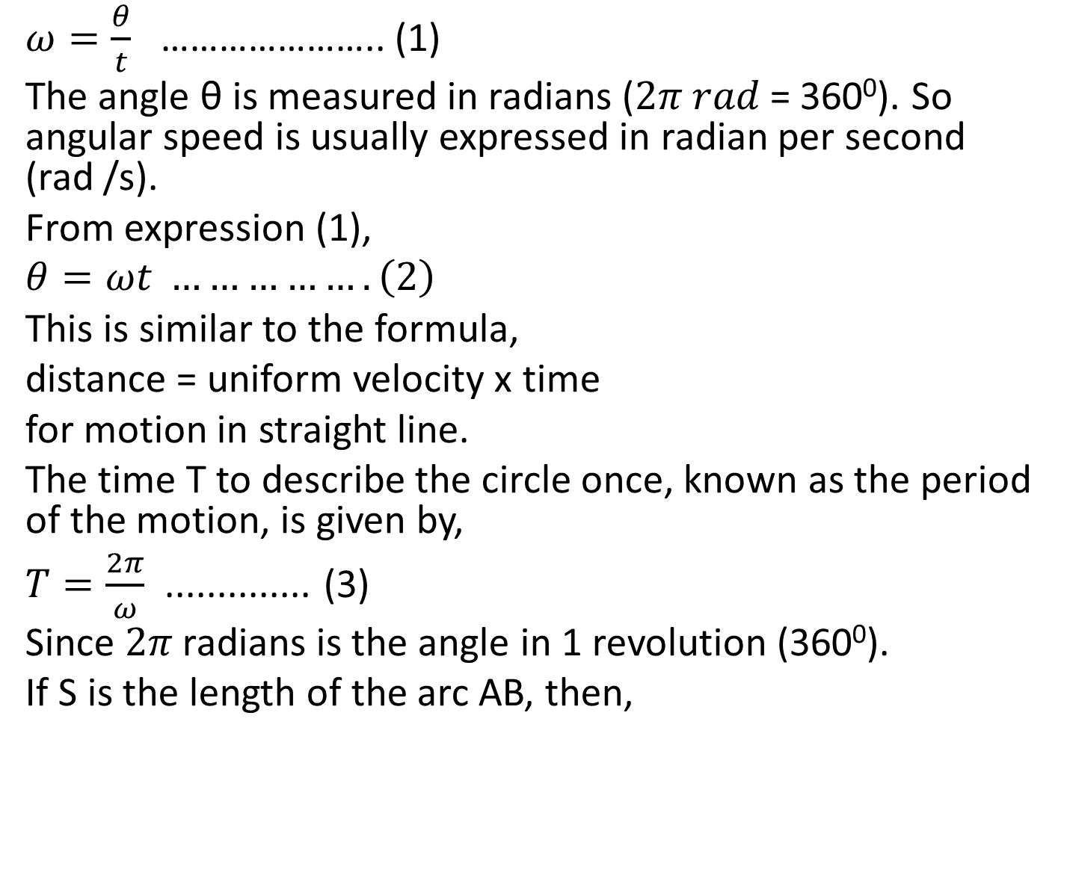
$ω=\frac{θ}{t}$ ………………….. (1)
The angle θ is measured in radians ($2π rad$ = 360⁰). So angular speed is usually expressed in radian per second (rad /s).
From expression (1),
$$θ=ωt ……………. \left(2\right)$$
This is similar to the formula,
distance = uniform velocity x time
for motion in straight line.
The time T to describe the circle once, known as the period of the motion, is given by,
$T=\frac{2π}{ω}$ .............. (3)
Since $2π$ radians is the angle in 1 revolution (360⁰).
If S is the length of the arc AB, then,

Slide 3
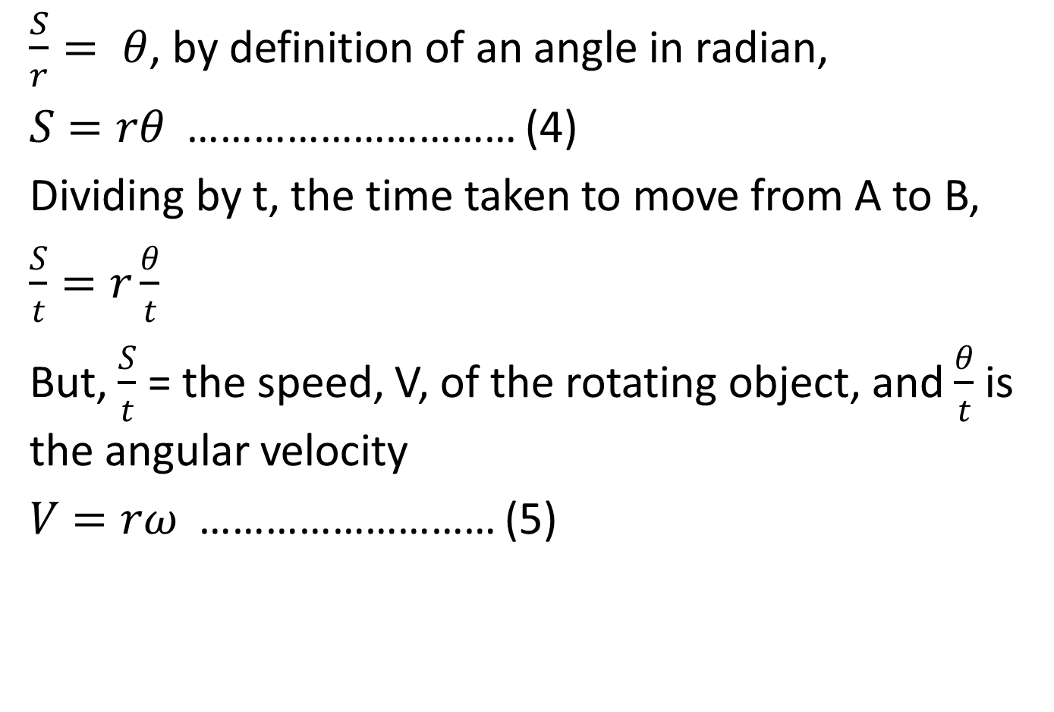
$\frac{S}{r}= θ$, by definition of an angle in radian,
$S=rθ$ ………………………… (4)
Dividing by t, the time taken to move from A to B,
$\frac{S}{t}=r\frac{θ}{t}$
But, $\frac{S}{t}$ = the speed, V, of the rotating object, and $\frac{θ}{t}$ is the angular velocity
$V=rω$ ……………………… (5)

Slide 4
Example
A model car moves round a circular orbit track of radius 0.3m in 2 revolution per second.
What is:
(a). the angular speed
(b). the period T
(c). the speed V of the car?
(d). Find also the angular speed of the car if it moves with a uniform speed of 2m/s in a circle of radius 0.4m

Slide 5
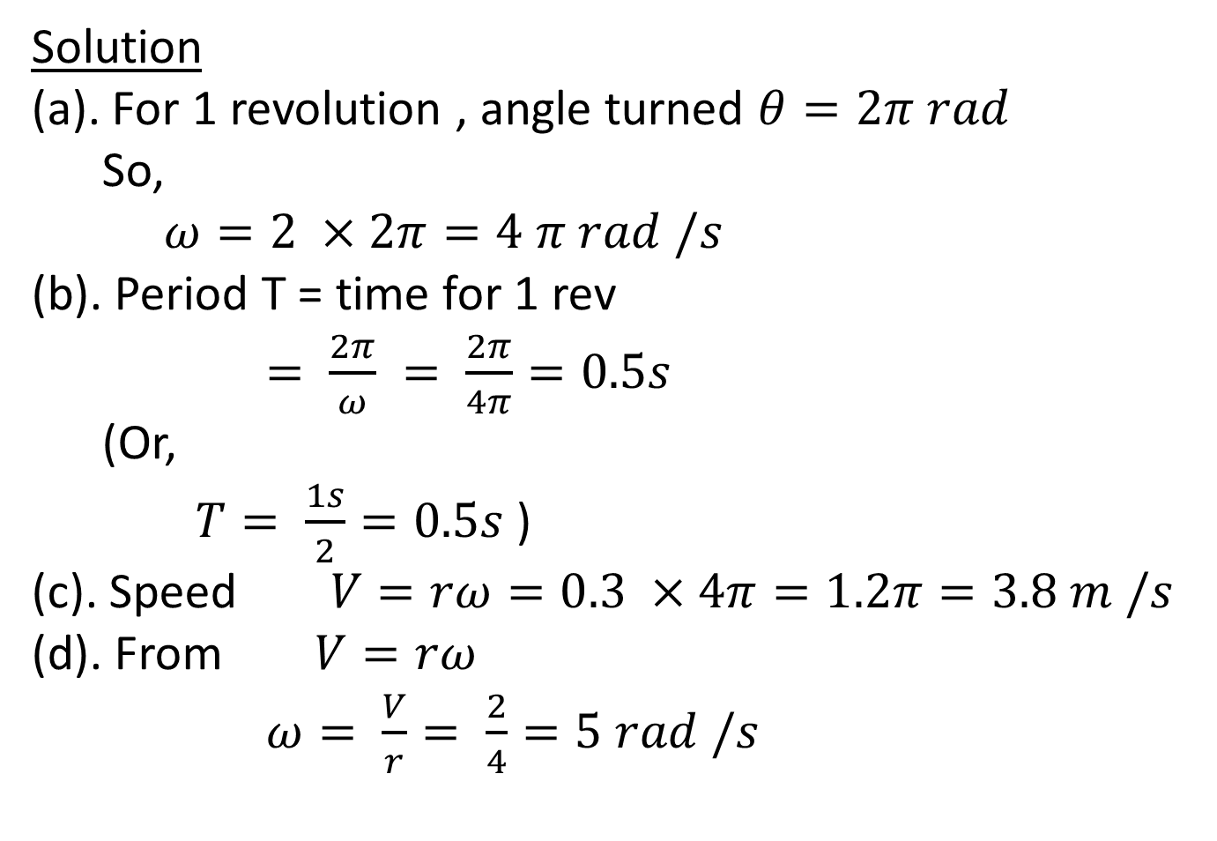
Solution
(a). For 1 revolution , angle turned $θ=2π rad$
So,
$ω=2 ×2π=4 π rad /s$
(b). Period T = time for 1 rev
$= \frac{2π}{ω} = \frac{2π}{4π}=0.5s$
(Or,
$T= \frac{1s}{2}=0.5s$ )
(c). Speed $V=rω=0.3 ×4π=1.2π=3.8 m /s$
(d). From $V=rω$
$ω= \frac{V}{r}= \frac{2}{4}=5 rad /s$

Slide 6
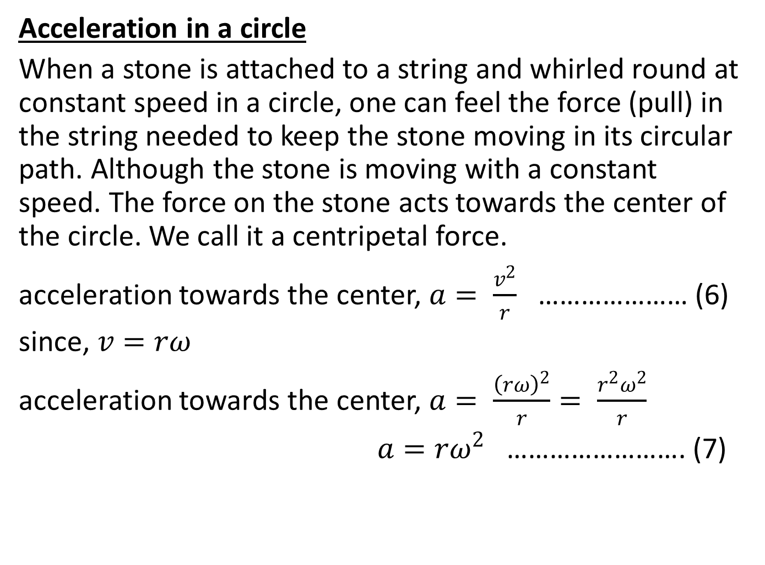
Acceleration in a circle
When a stone is attached to a string and whirled round at constant speed in a circle, one can feel the force (pull) in the string needed to keep the stone moving in its circular path. Although the stone is moving with a constant speed. The force on the stone acts towards the center of the circle. We call it a centripetal force.
acceleration towards the center, $a= \frac{v^{2}}{r}$ ………………… (6)
since, $v=rω$
acceleration towards the center, $a= \frac{{\left(rω\right)}^{2}}{r}= \frac{r^{2}ω^{2}}{r}$
$a=rω^{2}$ ……………………. (7)

Slide 7
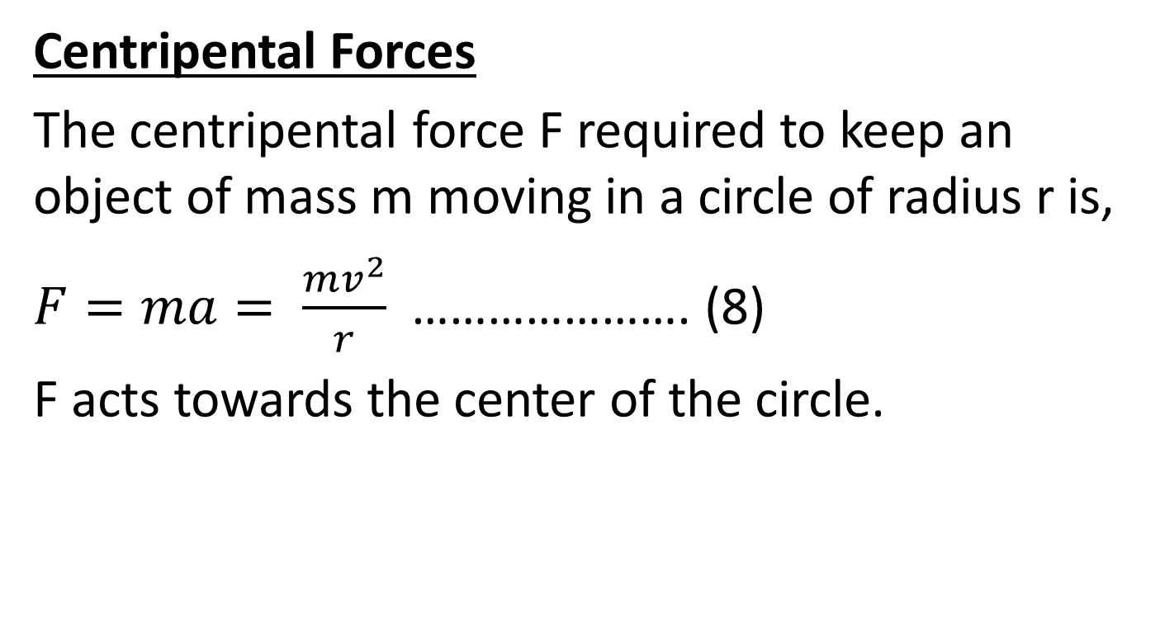
Centripental Forces
The centripental force F required to keep an object of mass m moving in a circle of radius r is,
$F=ma= \frac{mv^{2}}{r}$ …………………. (8)
F acts towards the center of the circle.

Slide 8
TUTORIALS
(1). A stone of mass 0.6 Kg attached to a string of height 0.5 m, is whirled in a horizontal circle at a constant speed. If the maximum tension (force) in the string is 30 N before it breaks, calculate
(a). the maximum speed of the stone
(b). the maximum number of revolution it can make
(2). An object of mass 4 Kg moves round a circle of radius 6 m with a constant speed of
12 m/s. Calculate,
(a). the angular speed
(b). the force towards the center

